Slide 1
Welcome!
Let’s Mix it up! Change tables from Yesterday
Please do not shuffle cards, nor write on the game boards.
Min 4, Max 5 people per table

Slide 2
Workshop Objectives
To use an engaging simulation to highlight whole-system strategies for consideration in digital transformation and beyond.
To open up conversations related to leadership, collaboration and your impact on projects/initiatives.
To highlight the demonstrable impact systems thinking and innovation can have on system performance.

Slide 3
Agenda
The plan …
Introduction
FNER Round 1
Financial and Quality Baseline
People, not numbers, produce!
System Optimization
Team Huddle
FNER Round 2
Bring it home – It matters!

Slide 4
Experiential Learning
Mental Models
Results
Simulation
Decisions
Actions

Slide 5
Experiential Learning
What are the implications in your practicum?
Mental Models
Results
Simulation
Decisions
Actions

Slide 6
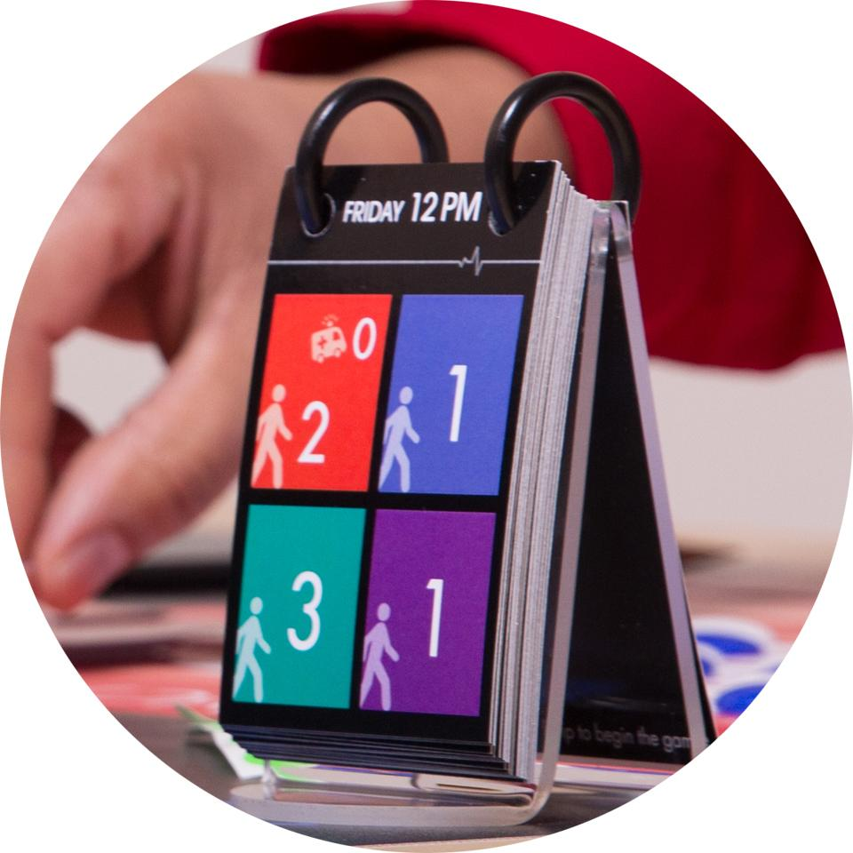
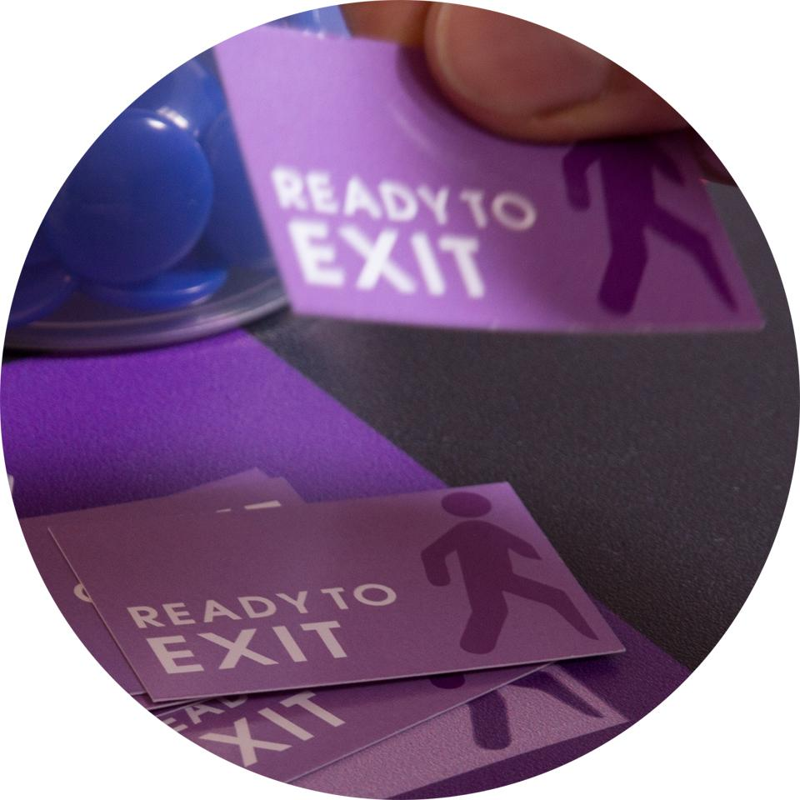



Steps Each Hour
Arrivals
Exits
Closed?
Staffing?
Paperwork

Slide 7




New Challenge:
Reorganize!
Stand up and move to the department on your left

Slide 8
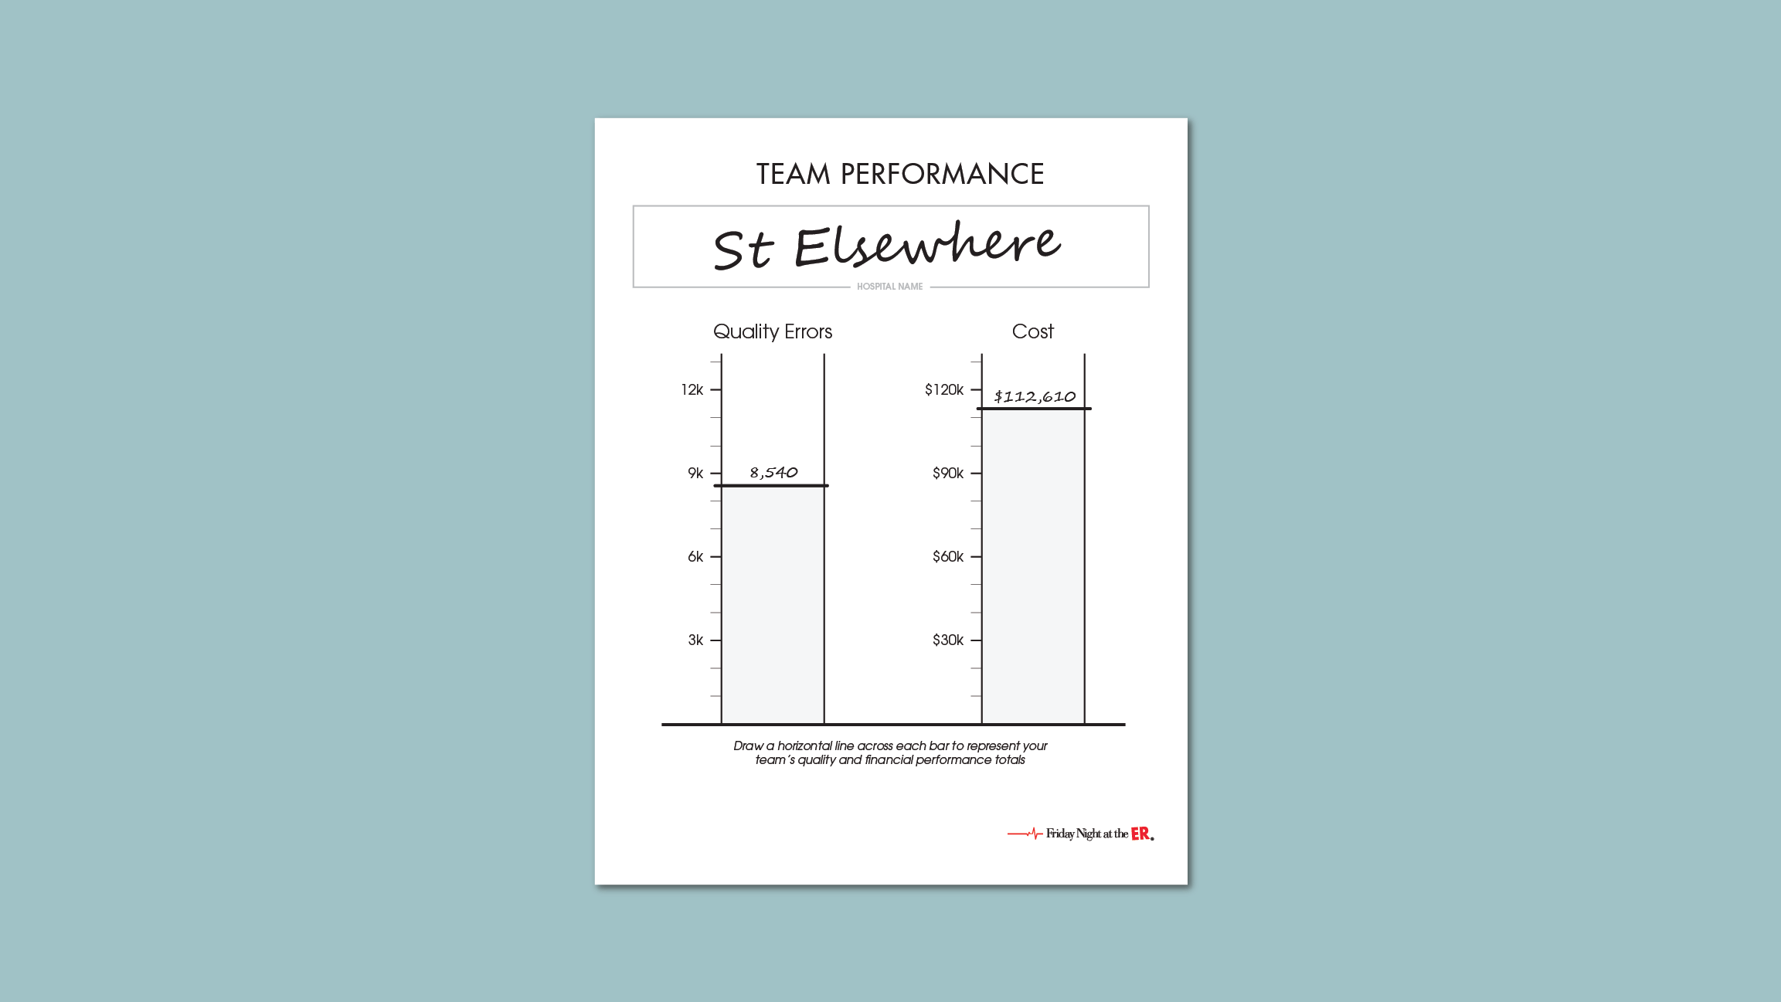
How to complete the chart

Slide 9
Team Dialogue
What felt real?
What drove your behavior?
What core strategies would you suggest for improvement?
Pause for a moment. Take this time to make notes on the following question:
What are the implications for your leadership function in an emerging digital environment?

Slide 10
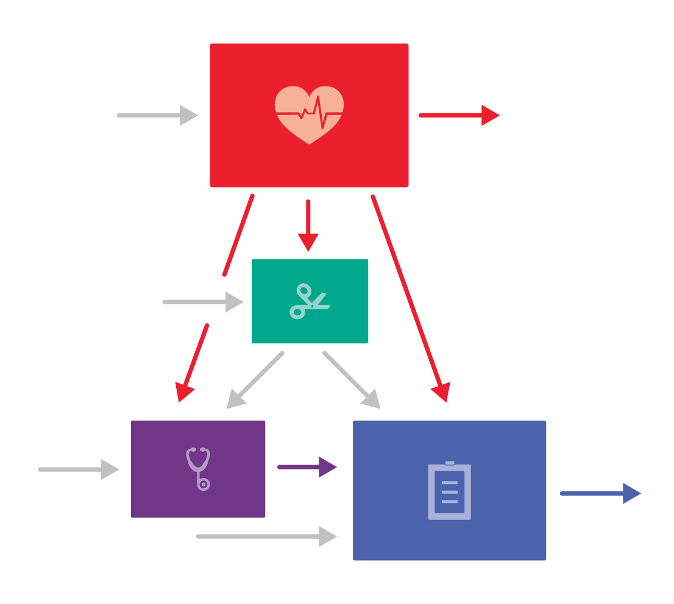
Process Flow
Who is responsible for Emergency waiting?

Slide 11
As you know, all organizations have interdependent functions
Procurement
Finance
Who is responsible for on-time delivery or provision of services in the context of the whole system?
Frontline Operators
HR
IT Platforms/ Support
Policy
Other Depts?

Slide 12
Excellence of the parts is necessary
…but not sufficient for whole system service performance

Slide 13

Optimize the system
…not just the parts.
How?
Three core strategies…

Slide 14
Core Strategy 1: Collaboration

Slide 15
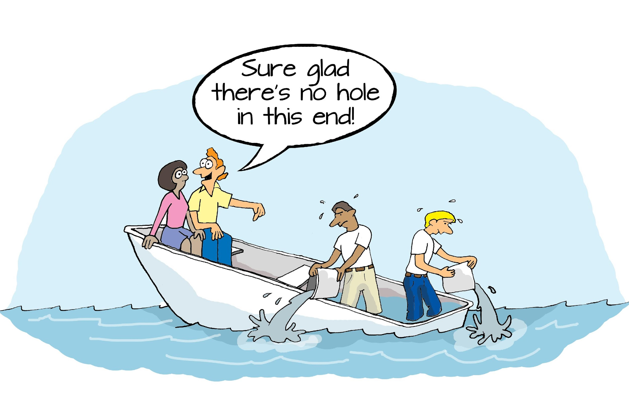
Collaboration is central to Agile principles and to the Government of Canada Digital Services Standards

Slide 16
Collaboration
In the simulation, for example:
Manage across department boundaries
Work as a team to use and share resources (staff, space)
Apply extra support where the need is the greatest

Slide 17
Collaboration Ladder
High
Share Responsibility
Jointly Plan
Treat Peers as Customers
Communicate Needed Info
Low
Minimal Communication

Slide 18
Barriers to moving up the Collaboration Ladder
High
Share Responsibility
Low Intercultural collaborative practice
That’s not in my job description
Jointly Plan
Treat Peers as Customers
We compete for resources
We don’t know what others need from us
Communicate Needed Info
Low
Minimal Communication

Slide 19
Core Strategy 2:
Innovation

Slide 20
How to Innovate
In the simulation, for example:
Share staff across departments
Treat Emergency patients in the hallway, in unused Surgery space
Place 2 patients in rooms with 2 staff

Slide 21
Here are 2 Key Questions to Ask
Do we want people to challenge “rules”?
Policies, practices, widely-held assumptions
What is OK and what is not OK to challenge?

Slide 22
Core Strategy 3:
Data-Driven

Slide 23
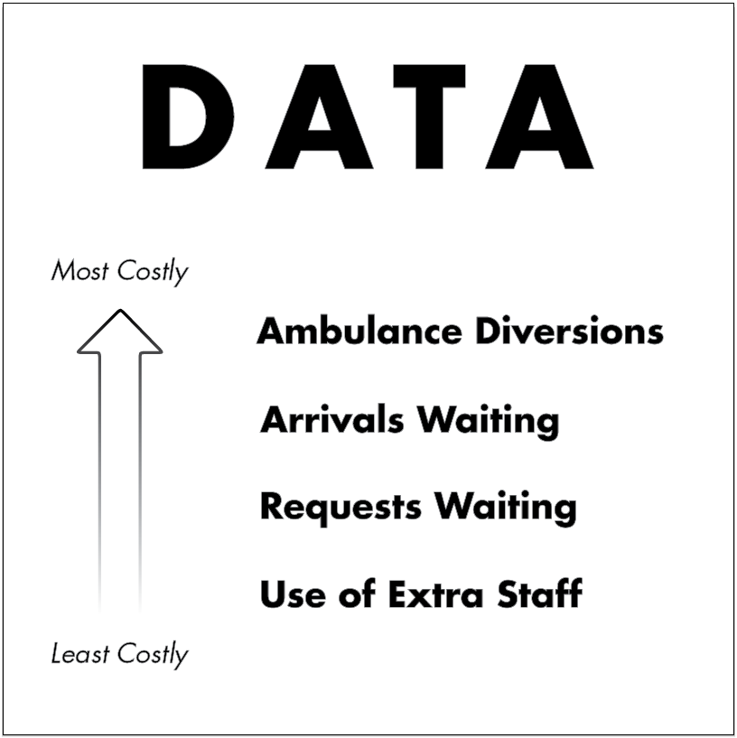
How to be Data Driven
In the simulation, for example:
Ask for the data to make the best decisions
Observe trends and anticipate needs

Slide 24
Do you have a dashboard?
Digital Transformation: what service data do you need, how will it be obtained, how will it be visible?

Slide 25
These 3 Core Strategies
are a Bundle
Collaboration
Innovation
Data-Driven

Slide 26
Our Core Strategies derive from 3 Key Principles of Systems Thinking
Systems Thinking
Friday Night at the ER
1. The parts of a system are interdependent
Collaboration
2. Our mental models powerfully influence our actions
Innovation
3. Systems must be able to learn and adapt
Data-driven decision making

Slide 27
Digital Transformation Relevance
Systems thinking and innovation are central to transformation
Collaboration is the essence of Agile and user-centred design
Data is the enabler of product relevance and sustainability

Slide 28
We already knew these strategies …didn’t we?
Collaboration
Innovation
Why don’t we routinely put them into practice?
Data-Driven

Slide 29
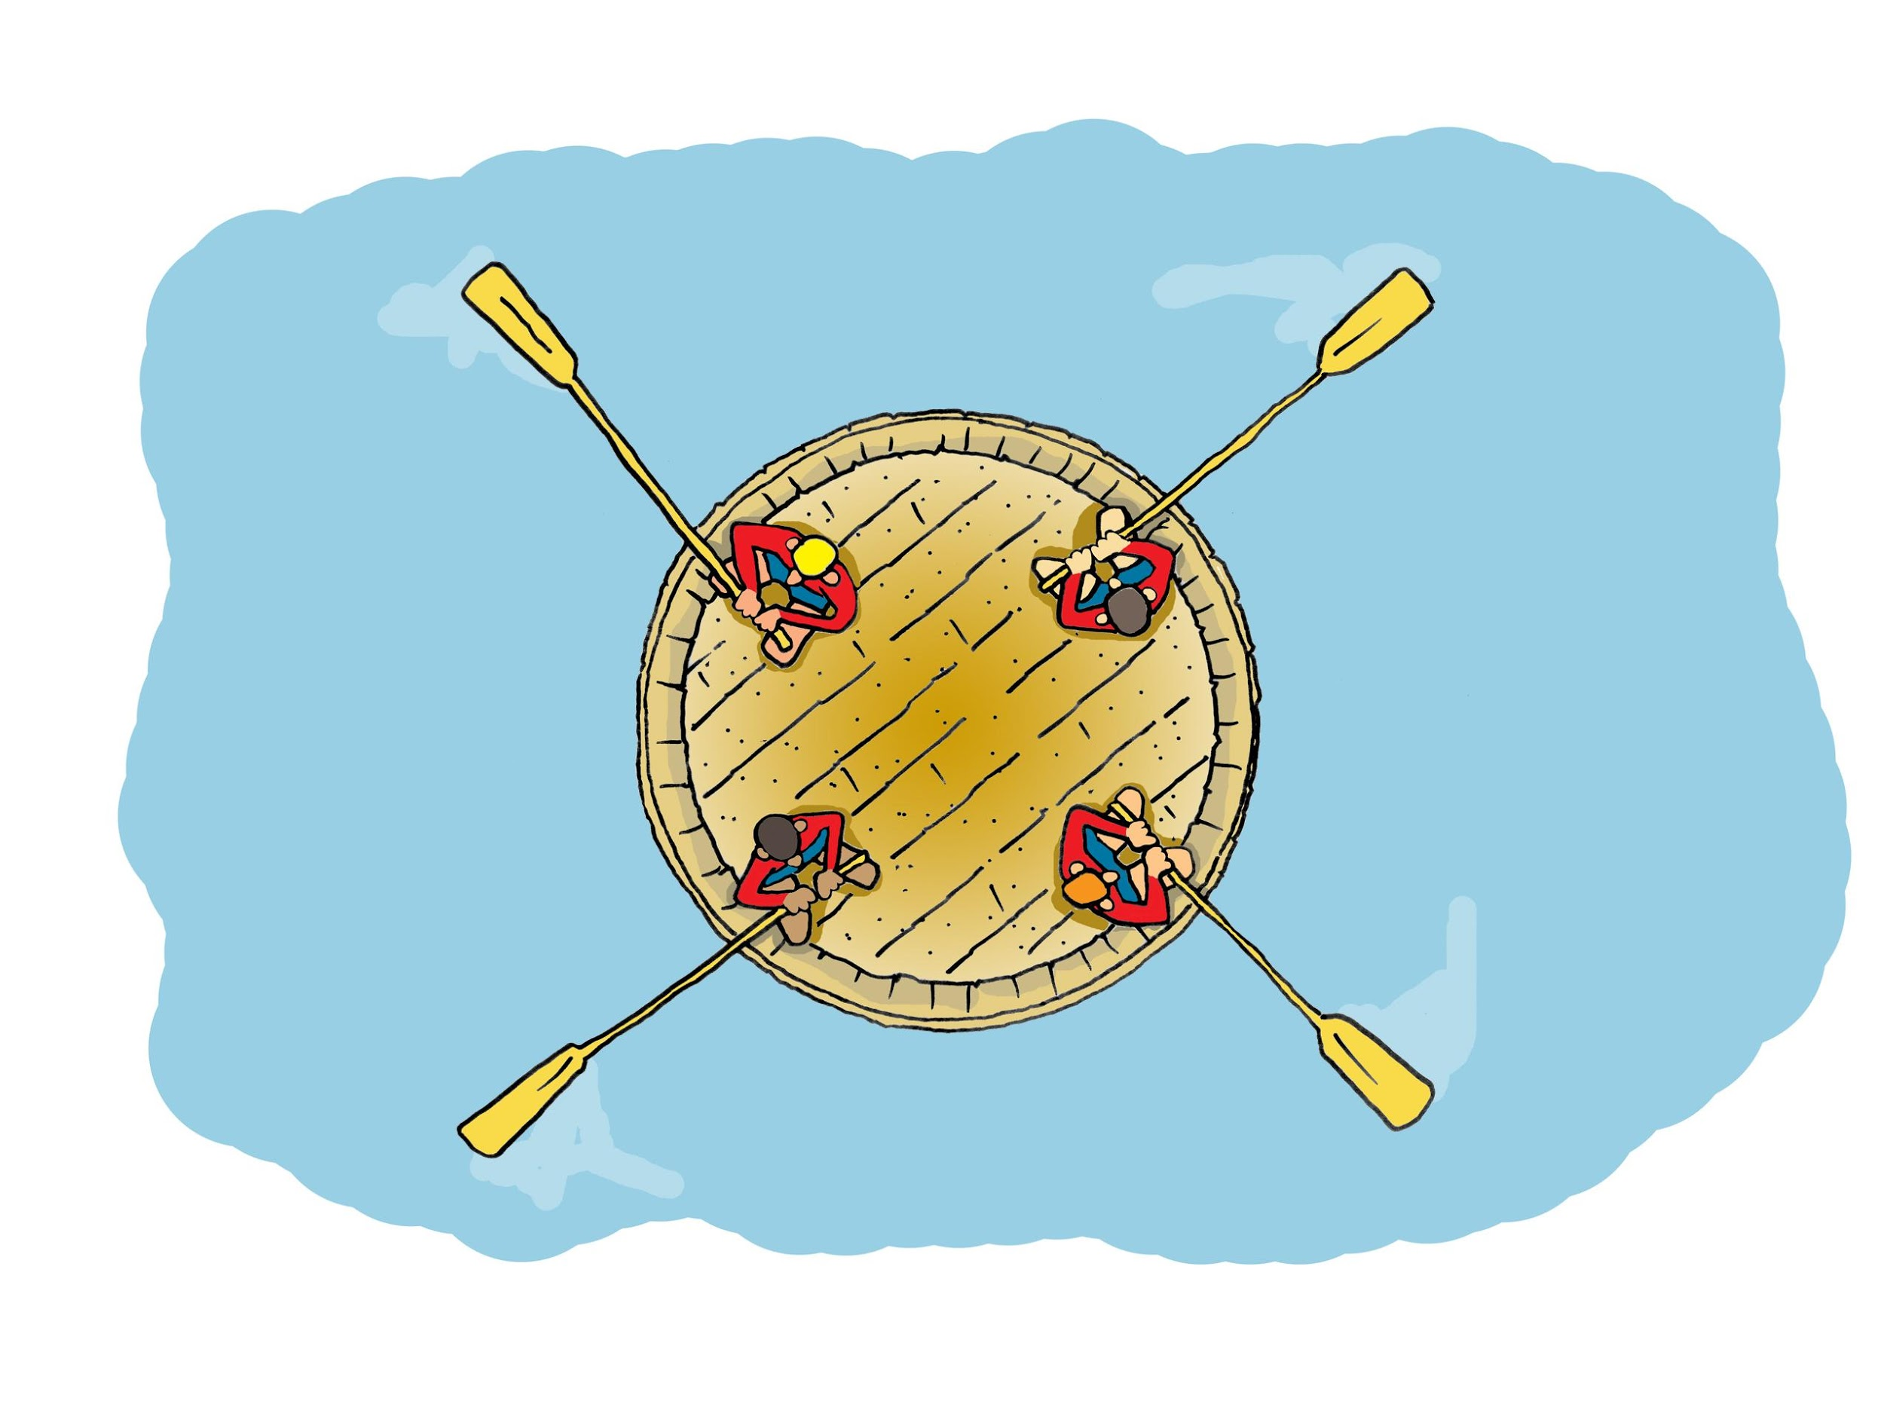
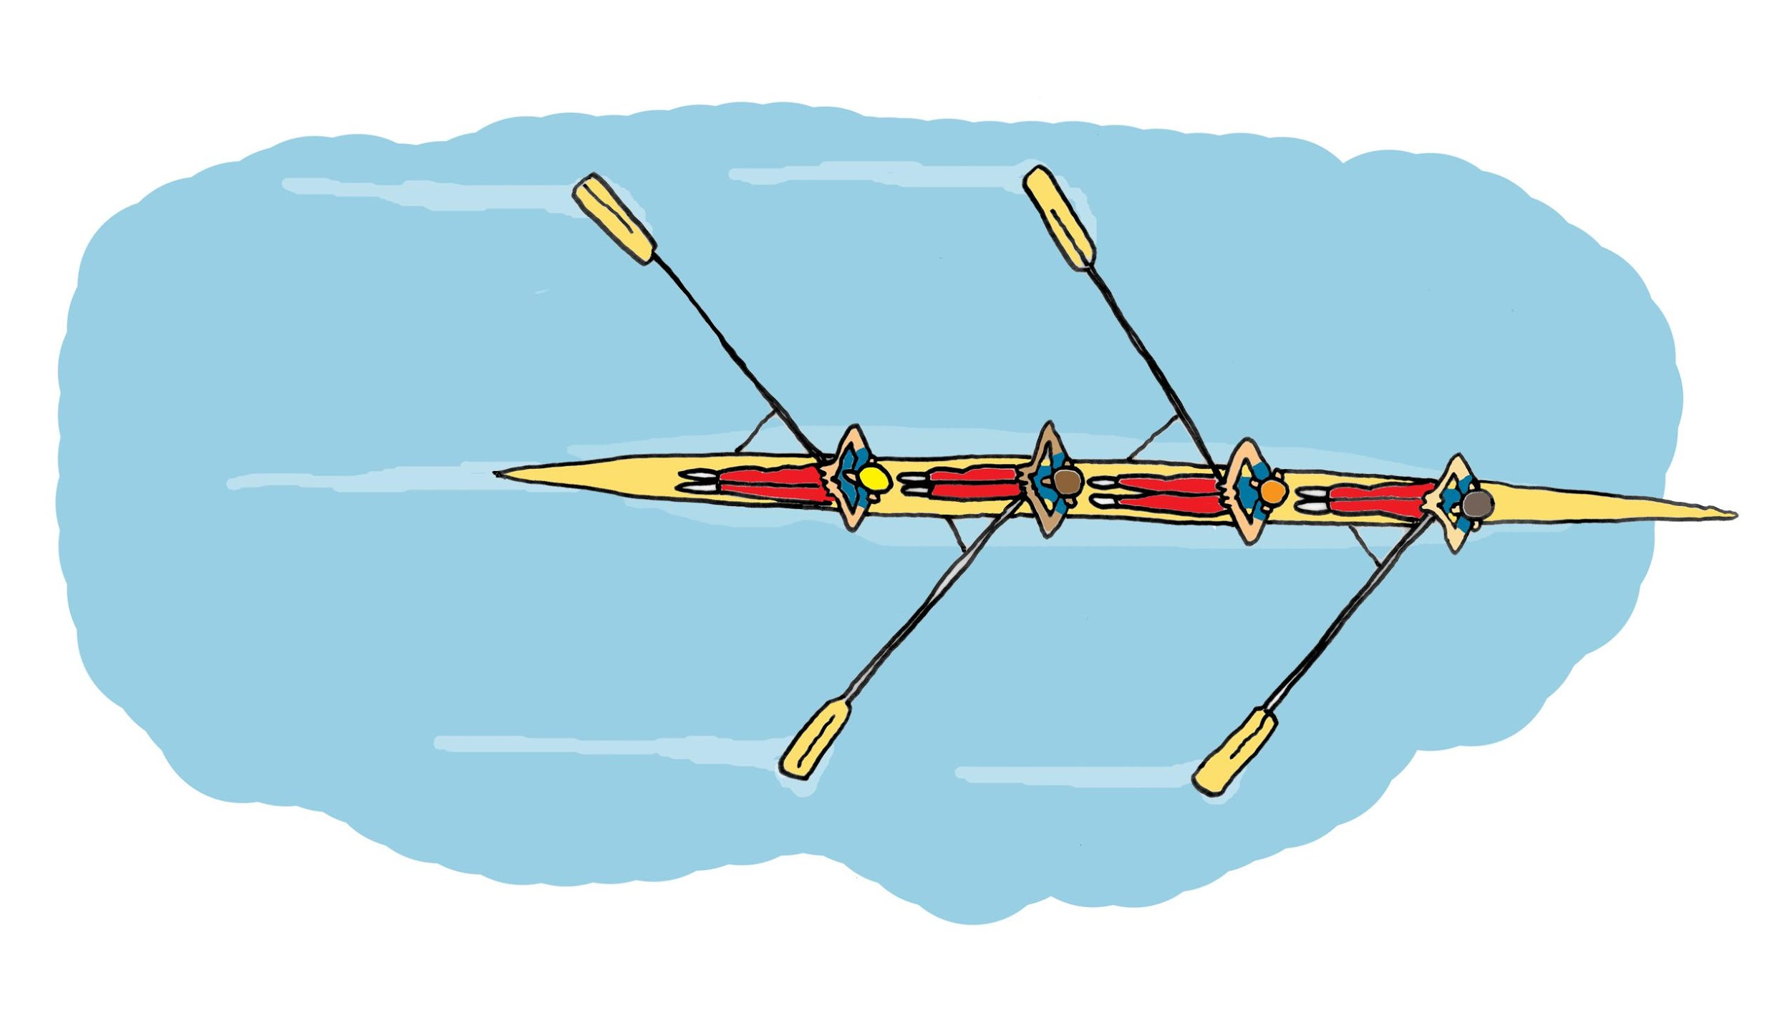
“Structure drives behavior” and Our behavior is often reflexive in spite of our awareness

Slide 30
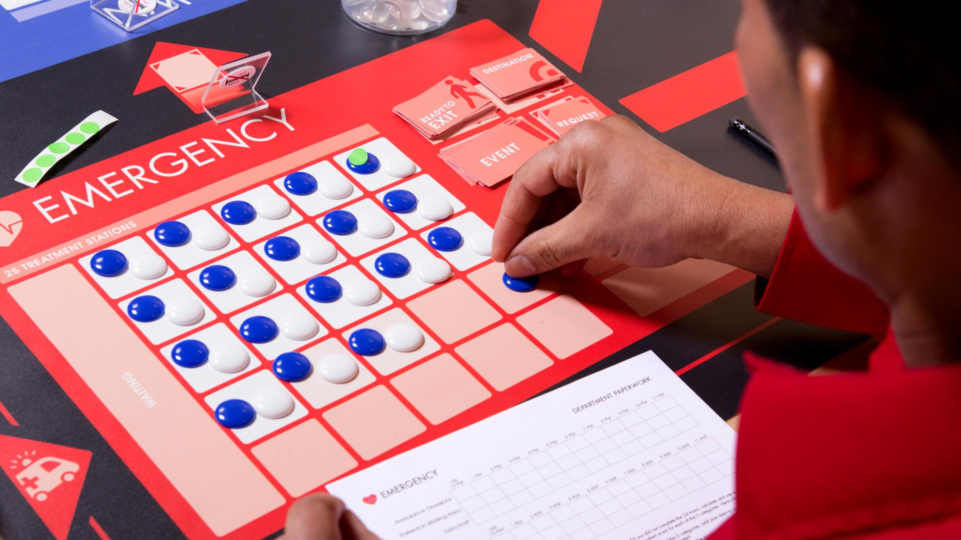
Some elements of structure in the simulation
Your role
Physical boundaries
Department paperwork
Your mental models

Slide 31
Familiar and Common Elements of Structure
Physical layout and environment
Performance measures
Reward systems
Information availability and visibility
Formal policies and procedures
Informal practices, cultural norms
Mental models

Slide 32
Table Talk In your experience and in what you have learned so far, what are some of the elements of structure that drive behavior in digital transformation teams?

Slide 33
These 3 Core Strategies
are a Bundle
Collaboration
Innovation
Data-Driven

Slide 34
Team Huddle Core Strategies as Polarities
Collaboration AND Individuation
Innovation AND Continuity
Data Driven Decisions AND Human Centered Decisions

Slide 35
New Challenge:
Reorganize!
Stand up and move to the department on your left

Slide 36
Performance Improvement
(R1 - R2)
___________
R1
X 100
=
% Change

